Slide 1
Are you about to host a gathering including food and transportation? Or supporting sustainable approach?

Slide 2
What its about?
To host a sustainable event, minimize environmental impact by
  choosing eco-friendly venues and vendors,
  implementing zero-waste policies,
  adopting sustainable catering,
  reducing transportation needs,
  and using digital solutions for communication and resources.

Slide 3
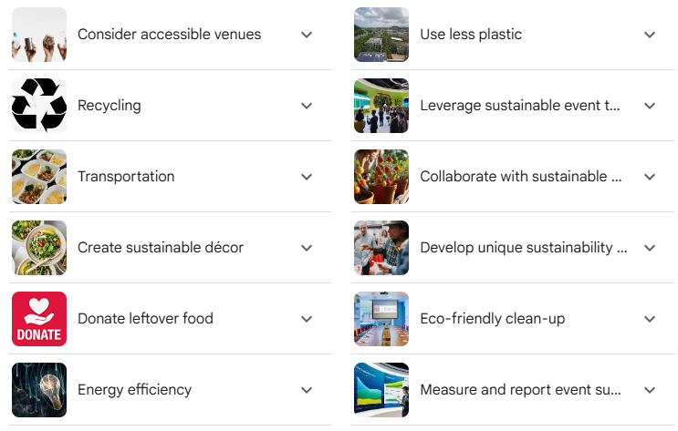
When hosting a sustainable event:

Slide 4
Hosting a sustainable event

Slide 5
Sustainable Catering & Food
Local & Plant-Based:
  Prioritize locally sourced, seasonal, and vegetarian or plant-based food options.
Waste Reduction:
  Minimize food waste by planning menus that utilize all parts of an ingredient and provide compostable take-away boxes.
Ethical Sourcing:
  Ensure any meat or fish served is sustainably sourced and ethically produced.

Slide 6
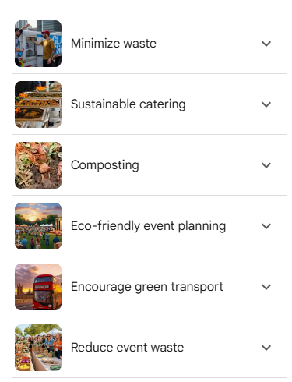

Slide 7
Other options...
Source locally ...
  Opt for local suppliers of food, beverages, and other event essentials whenever possible. Supporting small local businesses not only reduces carbon emissions from transportation but also fosters community engagement and economic growth.
Eco friedly swag options...
  Offer Eco-Friendly Promotional Products/Gifts ... Choose more earth-friendly products if you want to enlighten attendees' event experience with promotional gifts.

Slide 8
Energy & Transportation
Energy Efficiency:
  Use energy-efficient lighting and technology to reduce the event's energy consumption.
Transportation Support:
  Minimize attendee travel by choosing easily accessible venues and promoting public transport, car-sharing, and low-emission options.

Slide 9
Audience Engagement & Communication
Educate Attendees:
Inform your guests about the event's sustainability goals and encourage their participation in eco-friendly practices.
Communicate Achievements:
Showcase the positive impact and successes of your sustainable event to inspire attendees.

Slide 10
Measurement & Offsetting
Measure Impact:
Use tools to measure your event's carbon footprint and environmental impact to identify areas for improvement.
Offer Offsets:
Consider offering carbon offsetting options to help attendees mitigate the environmental impact of their travel.

Slide 11
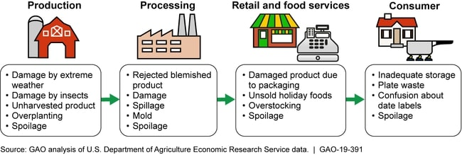
Stages of Supply Chain & Food Waste

