Slide 1


Kickoff meeting and first training
Helsinki, Finland 6-9th June 2025

Slide 2
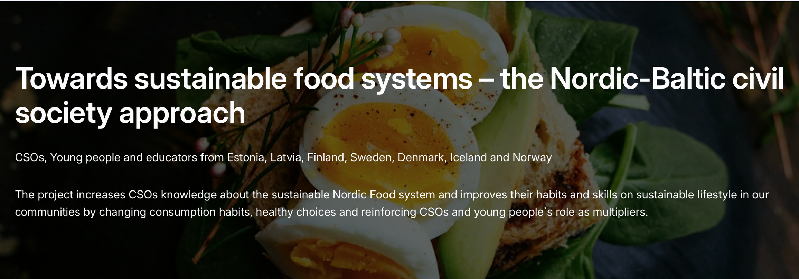
CSOs, Young people and educators from Estonia, Latvia, Finland, Sweden, Denmark, Iceland and Norway
The project increases CSOs knowledge about the sustainable Nordic Food system and improves their habits and skills on sustainable lifestyle in our communities by changing consumption habits, healthy choices and reinforcing CSOs and young people`s role as multipliers.

Slide 3
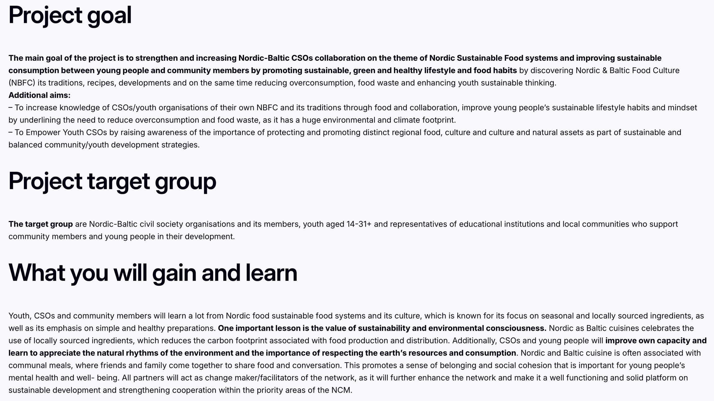

Slide 4
Project actions
  Virtual workshop on SDGs
  Kickoff meeting and I training on sustainable food systems in Finland, Helsinki (6-9th June 2025)
  II training and study visit on health, sustainability and consuming in Sweden, Lund/Malmö (28-31st August 2025)
  Partners and experts meeting for guidebook in Denmark, Copenhagen (6-9th November 2025)
  Nordic-Baltic Sustainability conference 2025 and Young Chef Award competition, Estonia, Toila (2-5th December 2025)
  Project digital guidebook in englsh (developed educational digital-guidebook on sustainable food system transition and role of CSOs with practical exercises, case studies and best practices, conference Sustainability network statement for decision makers)
  Project webpage with all educational materials

Slide 5
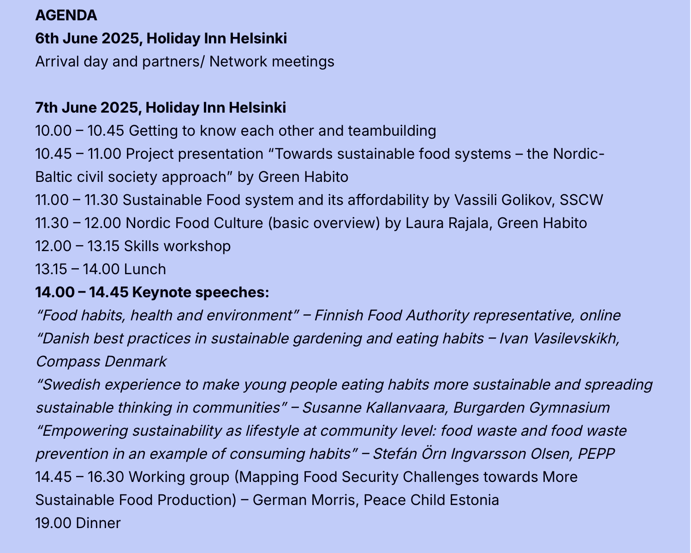

Slide 6
