Slide 1
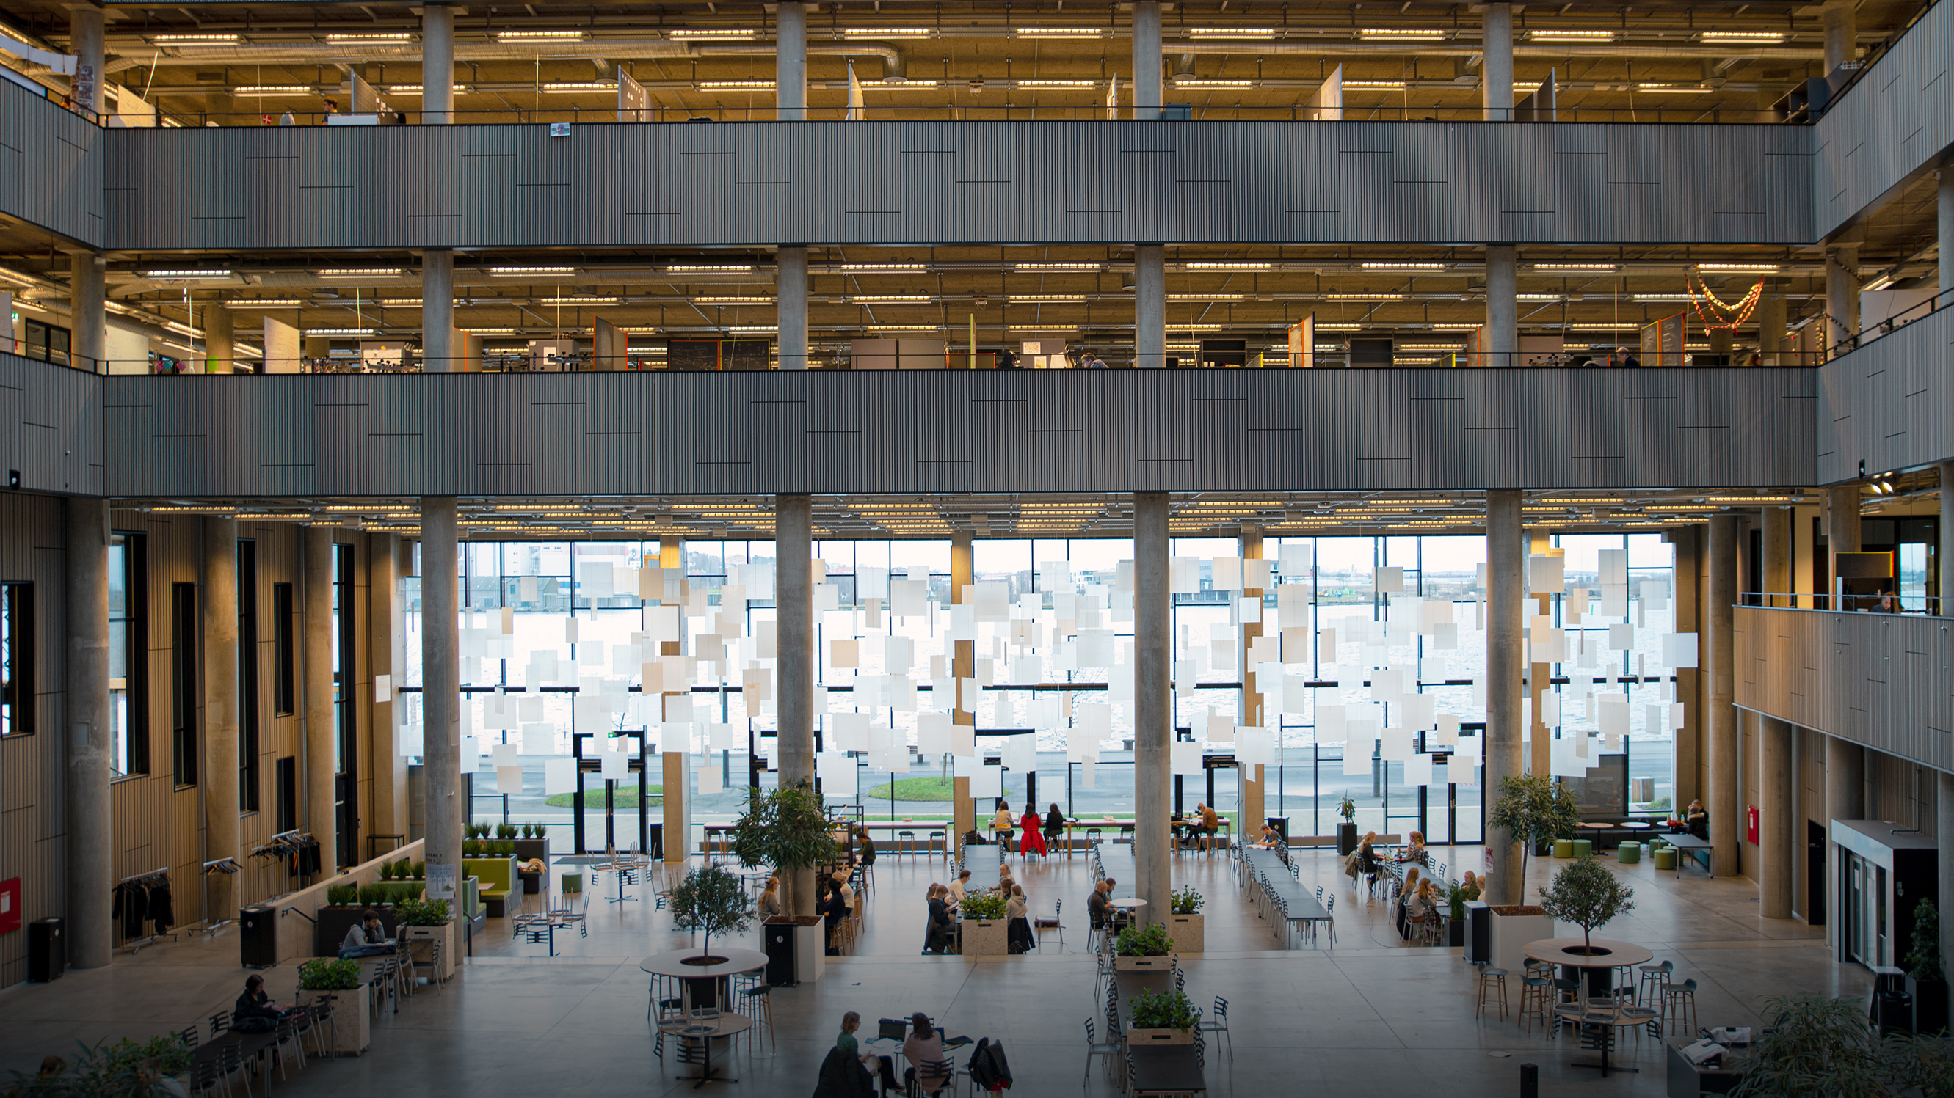

Experiences with transition towards production and consumption of plant-based food
Michael Søgaard Jørgensen
Department of Sustainability and Planning
Aalborg University, Copenhagen
Nordic Food Culture - Youth conference
Ribe, 24 September 2024

Slide 2
Overview
Background
Theories and methods
Why and how plant-based food in Denmark?
Innovation and/or imitation?
Status of development and production of plant-based foods
Measures that can support production and consumption of plant-based foods

Slide 3
Empirical background for presentation:
Analyses from 2022, 2012, 2009

Slide 4
How to analyse plant-based food?

Slide 5
Theoretical background for analysis of plant-based food
Sustainable transition: Path dependency and path creation, including the importance of companies' existing resources (physical and knowledge resources, market positions, etc.) for opportunities and inertia in transformation (Garud et al., 2010). Strong animal sector barrier?
Innovation in value chains: Value chains as "spaces" for power and learning processes between suppliers and customers through "life cycle management" (Garcia-Sanchez et al., 2004; Jørgensen & Forman, 2009)
Business models: The value proposition offer and the internal activities and resources as well as relationships in their value chains with customers, users and suppliers that enable problem solving in a company (Osterwalder & Pigneur, 2010)
Public regulatory instruments for development of markets for less environmentally harmful products by supporting product supply and/or demand and their interaction (Daugbjerg & Sønderskov, 2012)

Slide 6
Policy strategies for development of markets for ”green products”
Based on Daugbjerg & Sønderskov, 2012 | Support production (supply):
 | Low focus | High focus
Support consumption (demand): Low focus | Passive market development | Supply-driven development
High focus | Demand-driven development | Market development with ongoing interaction between supply and demand

Slide 7
Policy strategies for development of markets for ”green products”
Based on Daugbjerg & Sønderskov, 2012 | Support production (supply):
 | Low focus | High focus
Support consumption (demand): Low focus | Passive market development | Supply-driven development
High focus | Demand-driven development | Market development with ongoing interaction between supply and demand

Slide 8
Policy strategies for development of markets for ”green products”
Based on Daugbjerg & Sønderskov, 2012 | Support production (supply):
 | Low focus | High focus
Support consumption (demand): Low focus | Passive market development | Supply-driven development
High focus | Demand-driven development | Market development with ongoing interaction between supply and demand
Denmark unique in relation to regulation: Supporting both
development of production and consumption of organic food

Slide 9
Methods
Online/telephone interview with 25-30 food companies
Semi-structured research interview with interview guide
Desk-studies of experiences and policy measures in other countries
  Inspired by the concept travelling of ideas and concepts between different geographical and administrative (Czarniawska & Joerges,1996)

Slide 10
Why and how plant-based food in Denmark

Slide 11
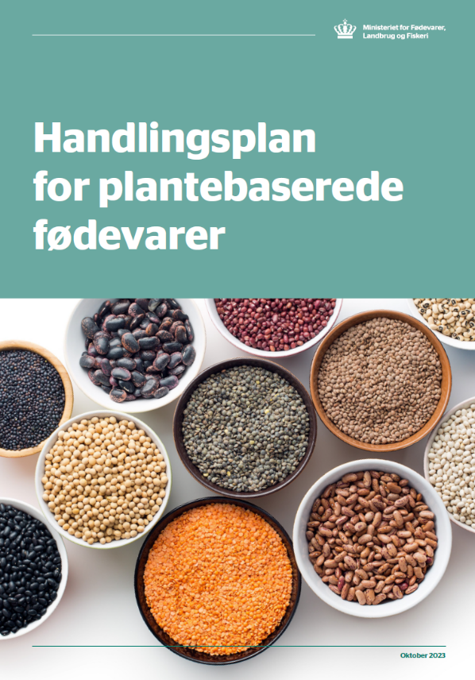
“Action plan for plant-based food” (Denmark, 2023)
The Minister for Food, Agriculture and Fisheries Jacob Jensen in the preface:
"Plant-based foods are the future. There is no doubt that if we want to reduce the climate footprint from agriculture, we must all – in line with the Official Dietary Guidelines – eat more plants.”
(Direct translation from Danish)

Slide 12
Why food as part of climate strategies?
(IDA, 2008; Concito, 2023)
Food one of the major contributors to Danish GHG emissions:
  Around 25% of the national GHG emissions
  Around 20% of the consumption-based GHG emissions
Energy and non-energy related emissions:
  Big differences in emissions between different types of food – high emissions from animal-based products (dairy and meat)
  Increased global animal food consumption because of increased global (average) wealth
Increasing demand (competition) for agricultural land and fibres/nutrients …. for use of biomass for materials, like bioplast, and energy

Slide 13
Consumption-based climate impact (footprint) from consumption areas
- climate impact as a consequence of resource consumption
Leisure equipment: 3%
Clothing: 3%
Personal care: 2%
Furniture: 2%
Public sector: 18%
Food: 20%
Transportation: 24%
Housing: 13%
Electricity and heating: 9%
Ref.: Concito: Denmark's global
consumption emissions, 2023 (in Danish)

Slide 14

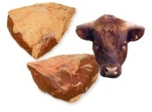


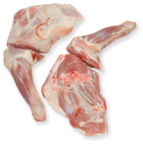
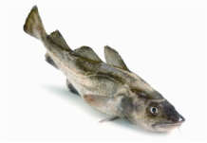


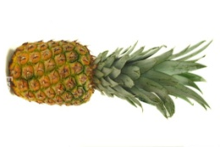
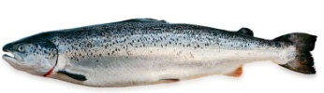

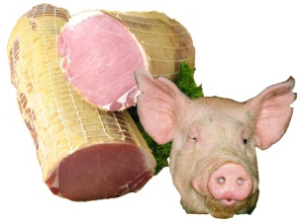


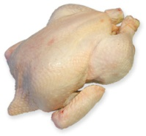
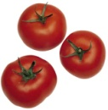
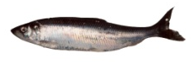




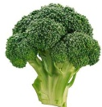
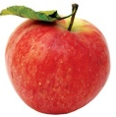

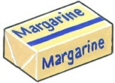
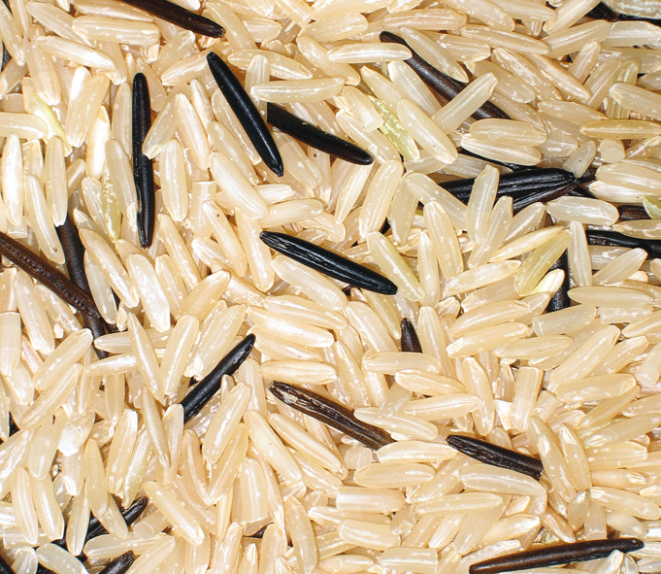
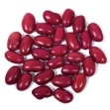
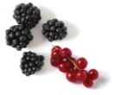

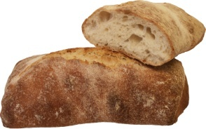
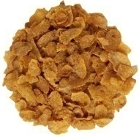
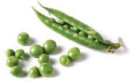
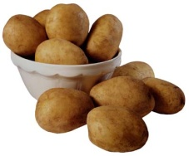
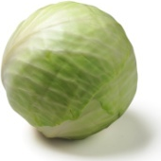
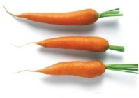


CO2-pyramid for food
The higher in the pyramid, the higher GHG-emissions per kilo food
Meat vs plant-based
Types of meat and plants
Shrimp
Butter
Cod
Salmon
Ref:
Lund & Madsen, 2008
Tropical fruit by air plane
Mackerel
Canned tuna
Herring
Milk
Beans
Fruit
Rice
Cereals
Bread
=Average of food group
0-2 CO₂-eq. per kg
2-8 kg CO₂-eq. per kg
8-20 kg CO₂-eq. Per kg

Slide 15
CO2-pyramid for food (waste)
The higher in the pyramid, the higher GHG-emissions per kilo food
Meat vs plant-based
Types of meat and plants
Shrimp
Butter
Cod
Salmon
Ref:
Lund & Madsen, 2008
Tropical fruit by air plane
Mackerel
Canned tuna
What is contributing to
the climaate impact of
the two foods?
Herring
Milk
Beans
Fruit
Rice
Cereals
Bread
=Average of food group
0-2 CO₂-eq. per kg
2-8 kg CO₂-eq. per kg
8-20 kg CO₂-eq. Per kg

Slide 16
Climate impact from different food groups in the average Danish diet
- combining GHG calculations and diet surveys
Meat products : 29%
Dairy products: 22%
Fruit and vegetables: 17%
Beverages: 15%
Grain and bread: 7%
Fish: 4%
Fat: 3%
Sugar and candies: 2%
Eggs: 1%
Ref.: Jørgensen, 2008
Notes:
Kombination af kostundersøgelser og klimadata

Slide 17
What is ”plant-based food”?

Slide 18
Different values in focus in development of plant-based food
Sufficiently nutritious?
  Much focus on pea (protein) as raw material =>
  Need to fear whether the consumer gets enough protein with plant-based foods?
  Processing ⬄ nutritional content and availability of nutrients
Is the product easy to integrate into the diet => increase consumption?
  Should the product imitate a corresponding animal product?
  Is the product easy to integrate into a busy everyday life?
Is the product produced sustainably?
  Organic raw materials?
  Residual products as raw material?

Slide 19
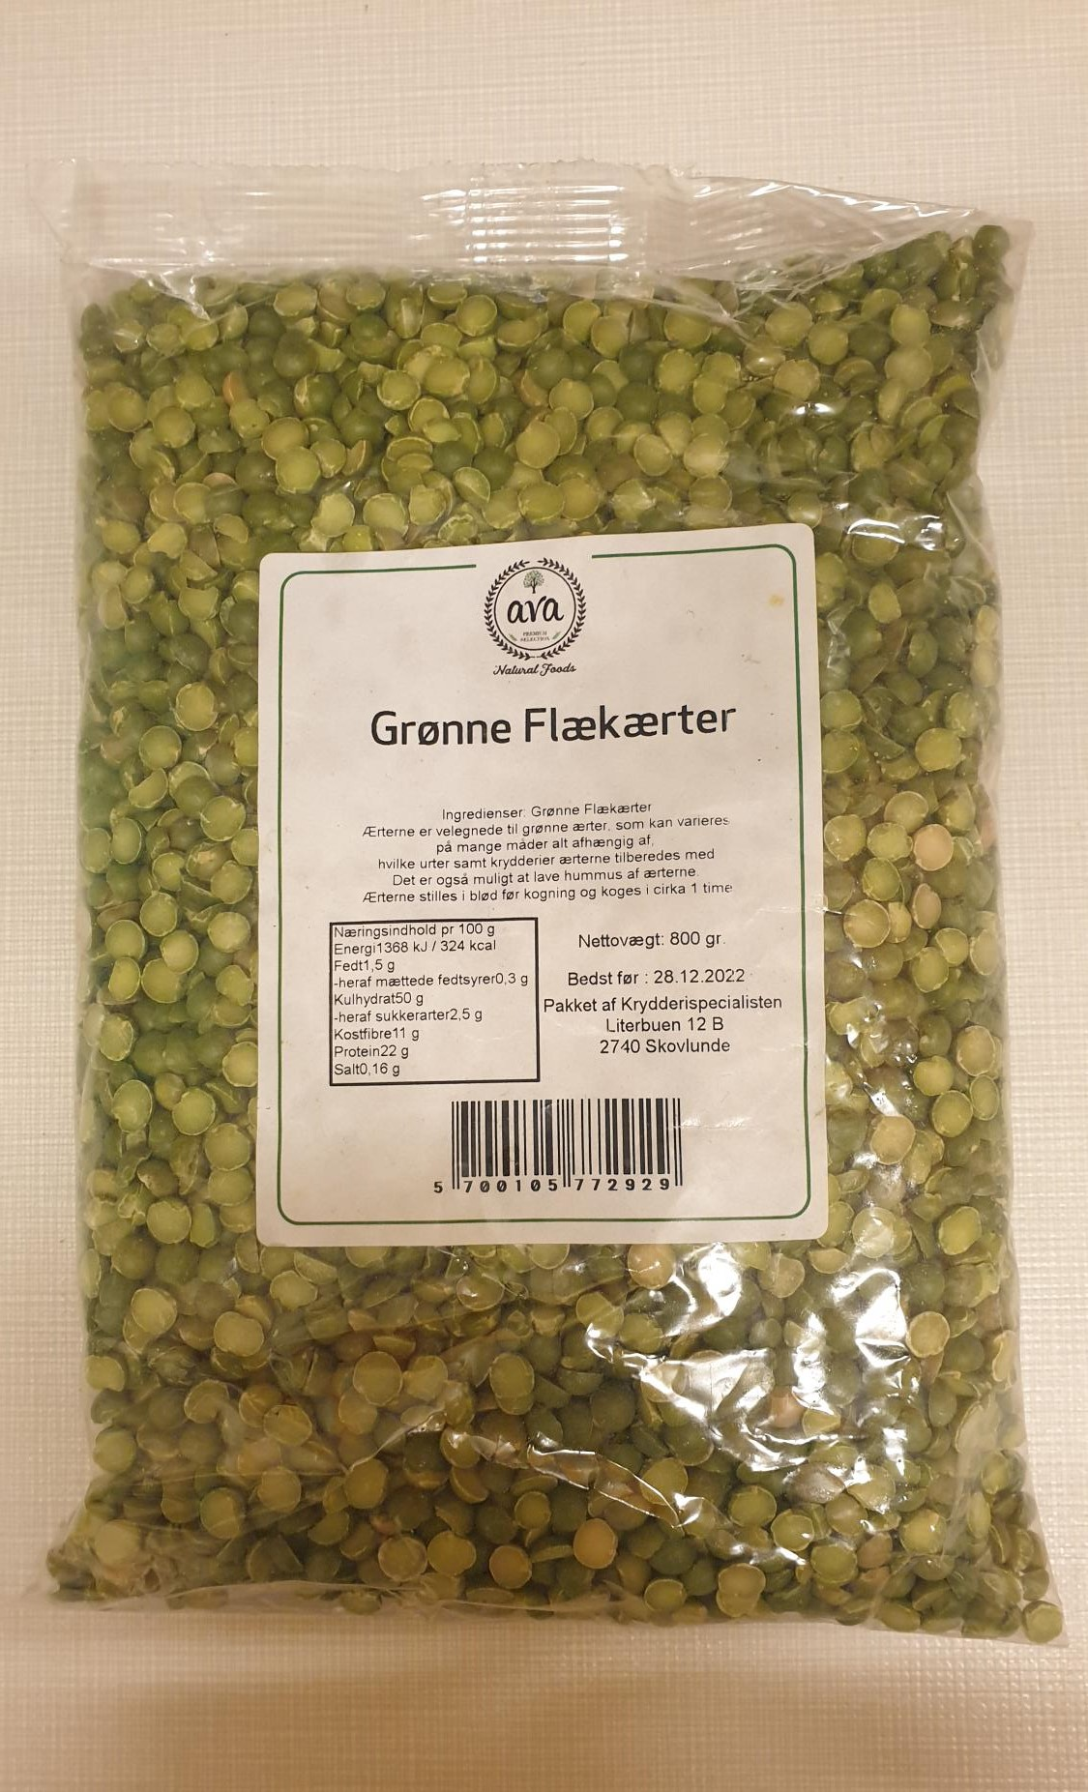
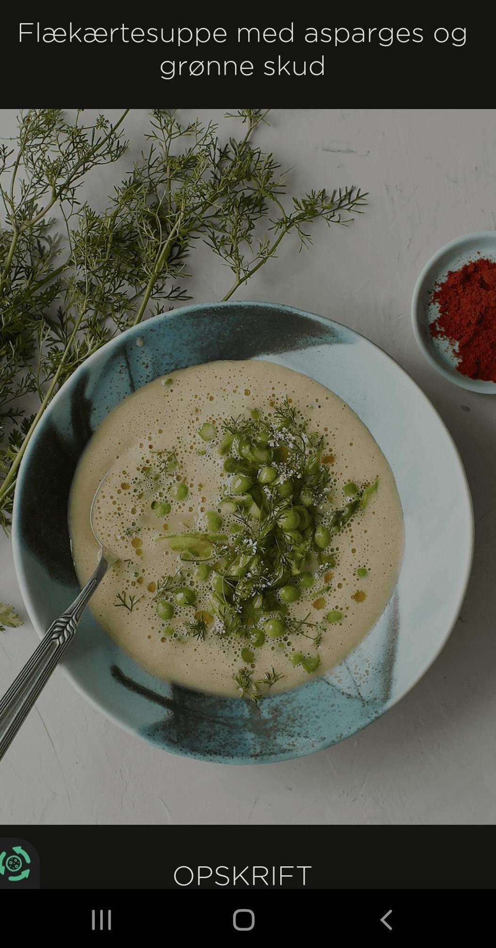
Protein-rich soup
- not an imitation

Slide 20
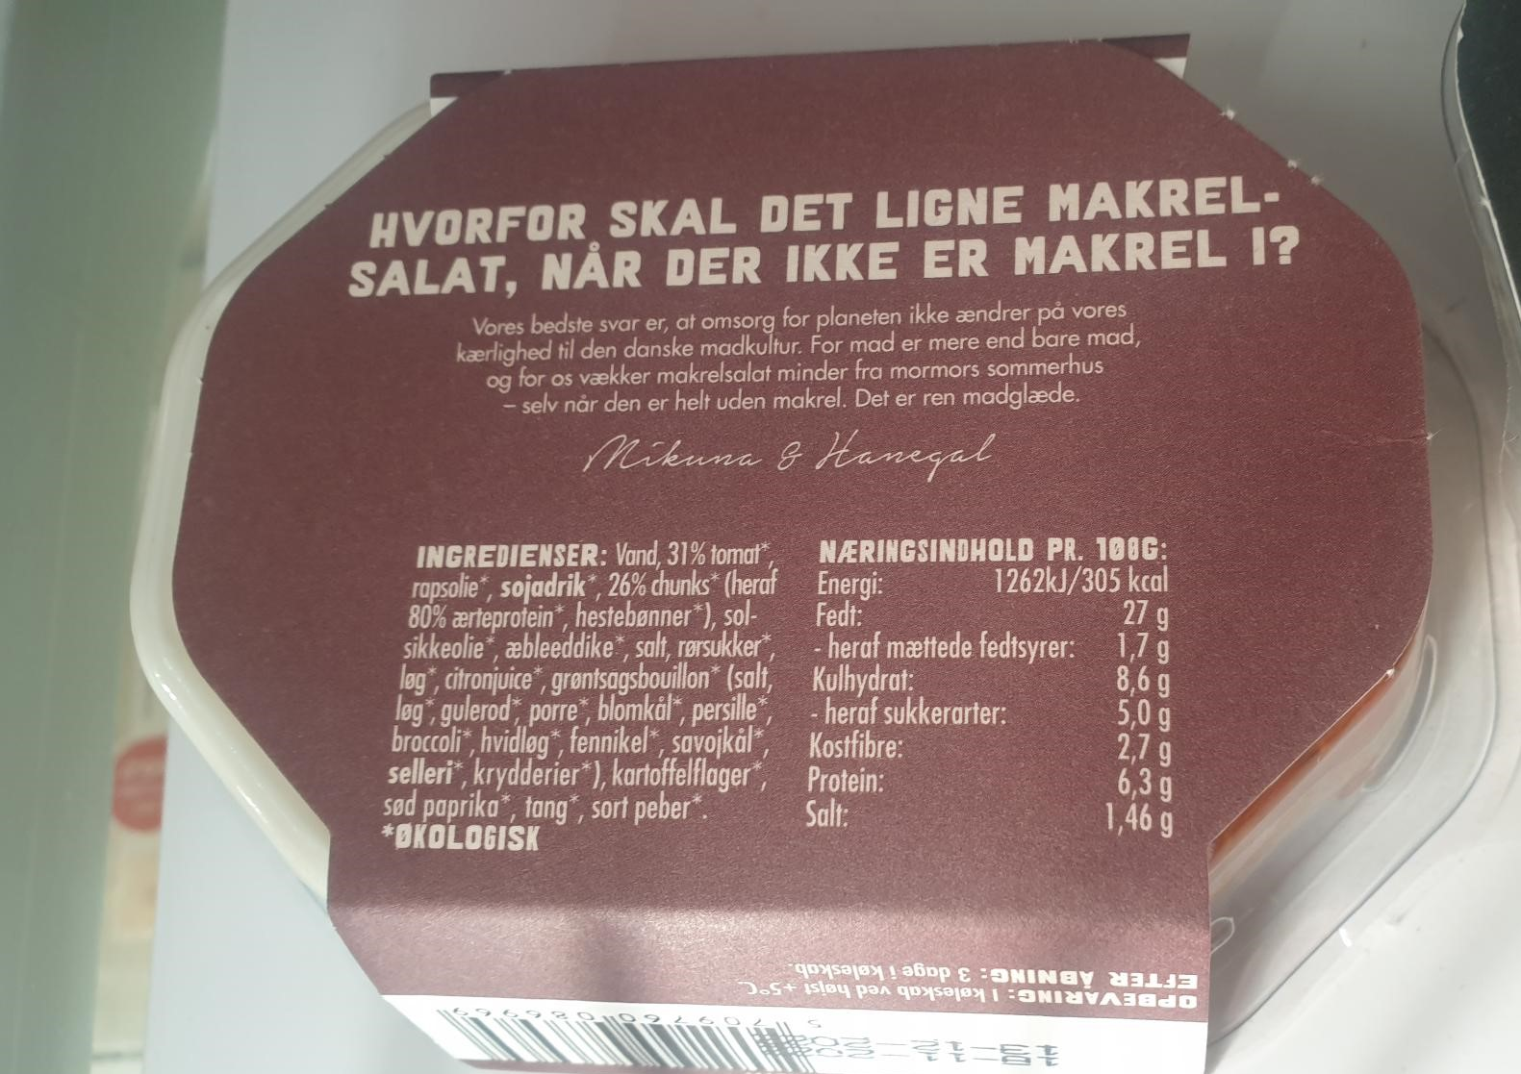
Different imitations
- transparent?
Genetic modified ingredients:
Production of animal milk protein:
Cow genes for milk inserted into yeast strain genes + added nutrients
Food culture: "Grandmother's" mackerel salad without mackerel - but with organic tomato, rapeseed oil and "chunks" of pea protein

Slide 21
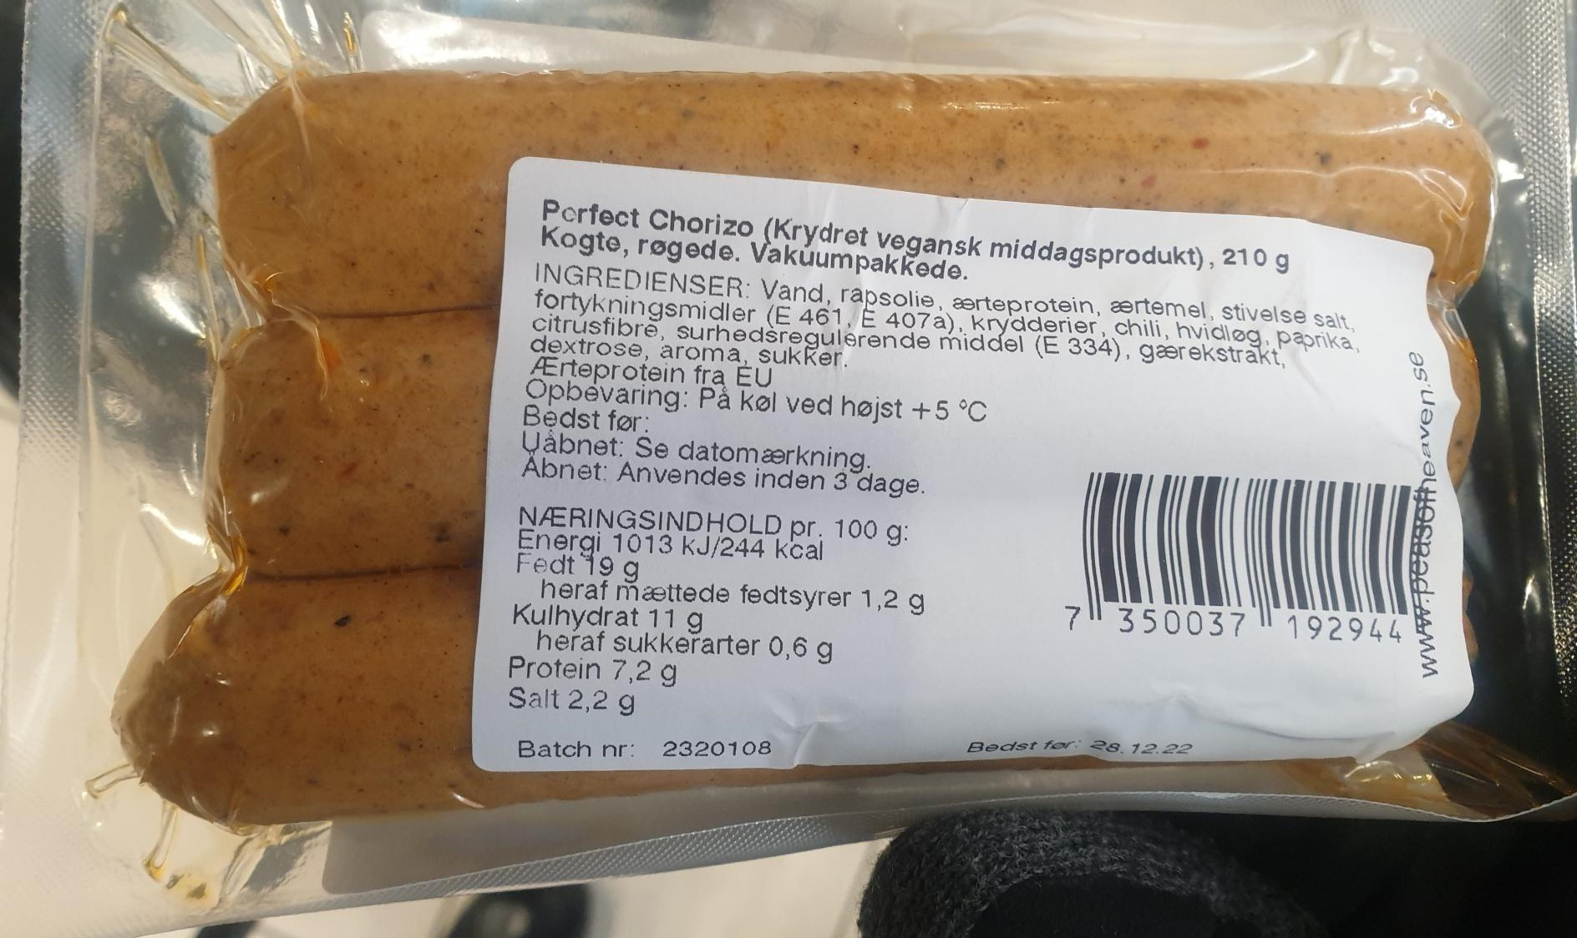
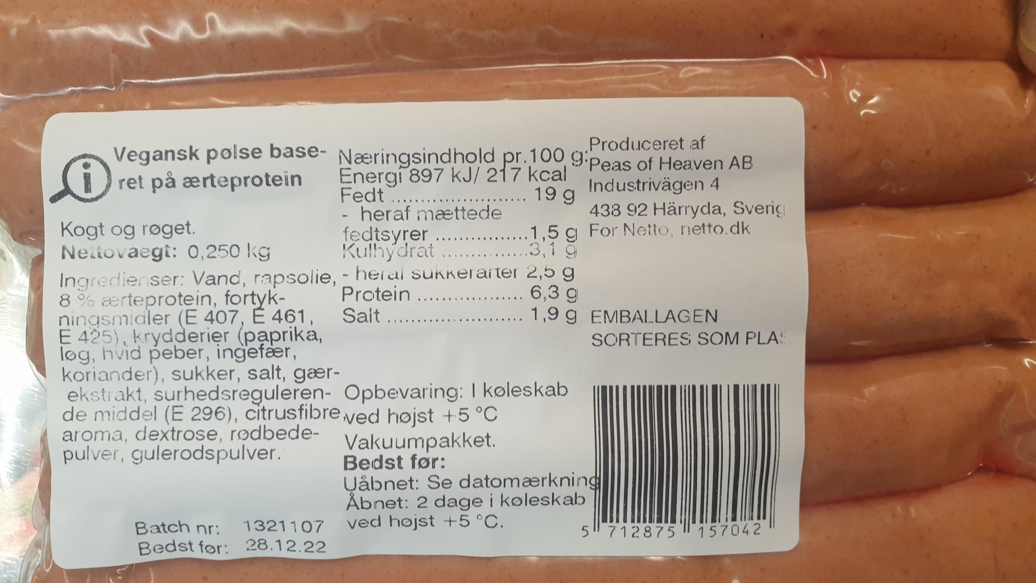
Imitation of know product types: Sausages
Processed pea protein from EU as important ingredient
+/- Natural colours: Powders from red beet + carrots

Slide 22
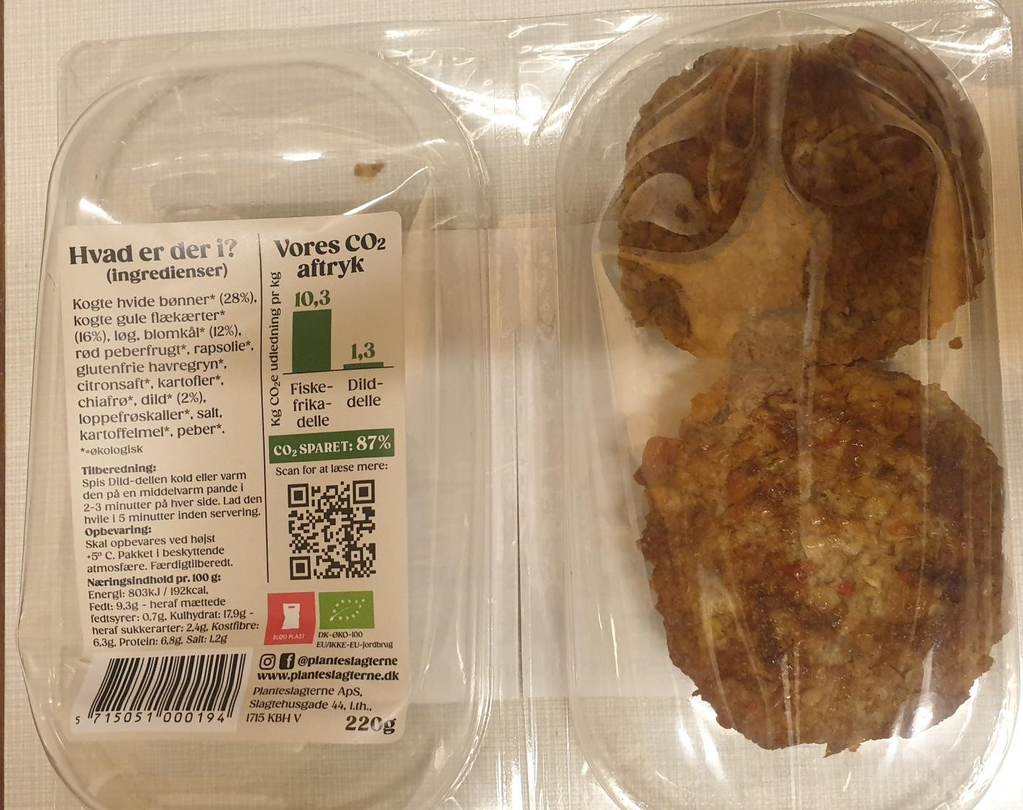
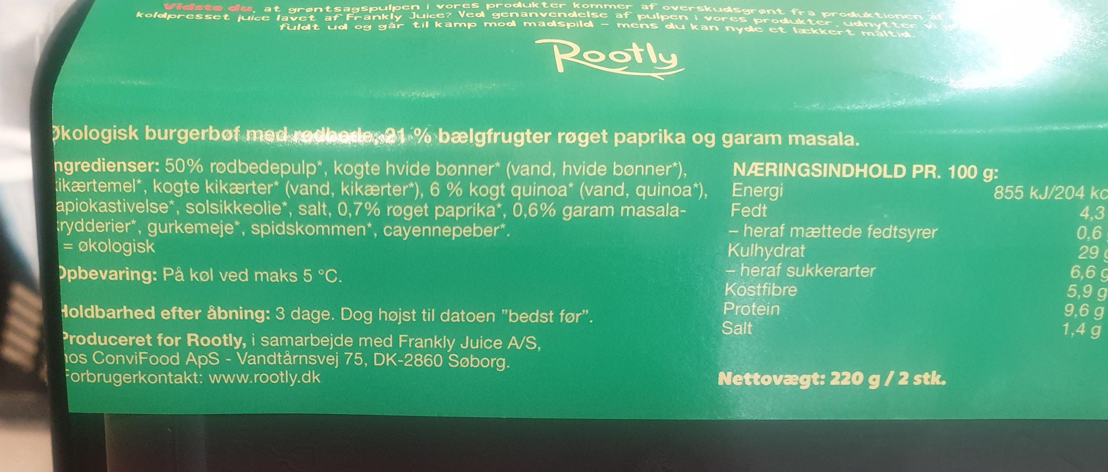
Known product types: Imitation or innovation?
Low-processed, ready-made, known product type:
Vegetable burger patty: Danish residual + boiled beans from ???
Organic products
Low-processed, ready-made, known product type: Vegetable patty with boiled beans and peas
1/8 of the climate impact from a similar product

Slide 23
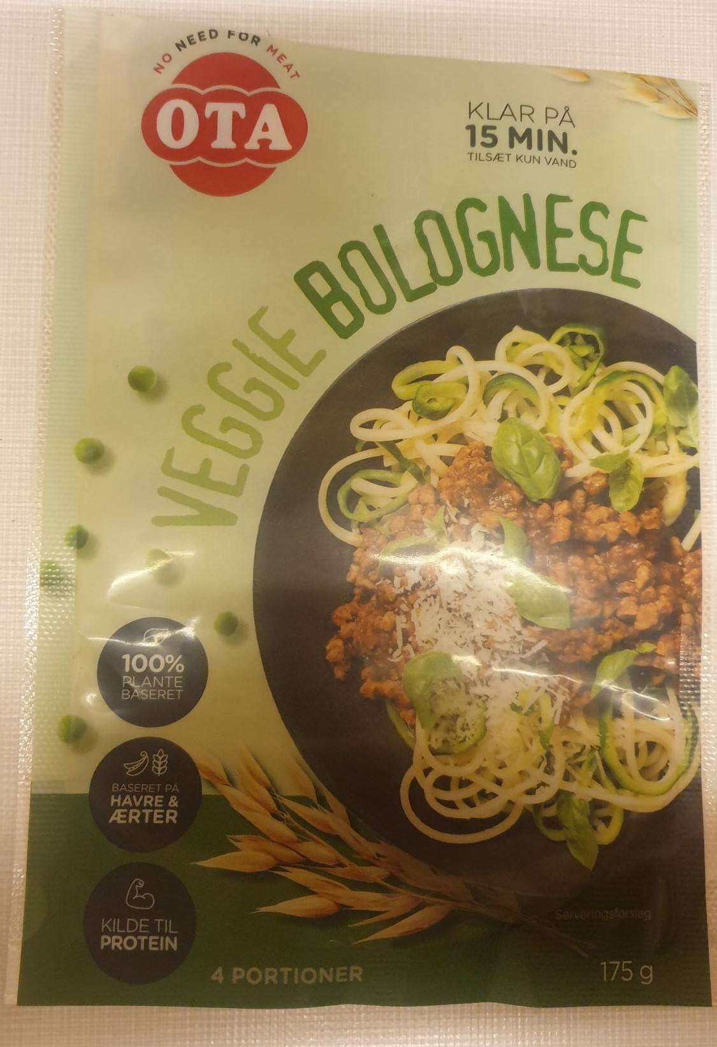
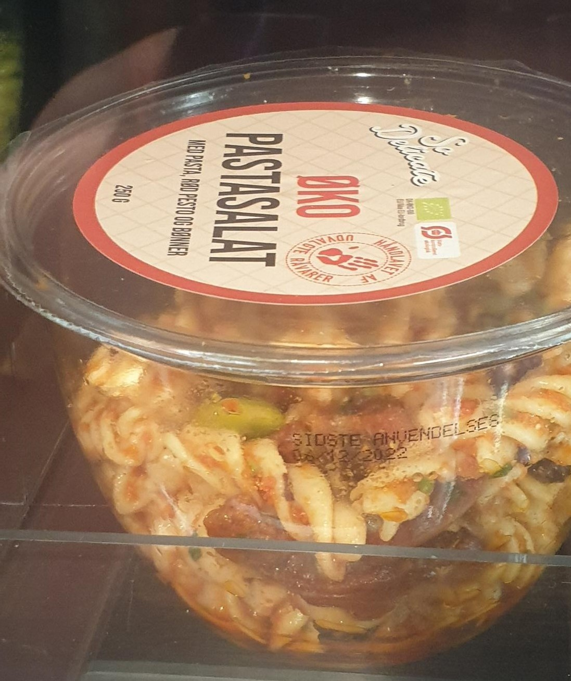
Convenient meals: Imitation or innovation?
Imitation of Bolognese:
Highlighted as a protein source
High degree of processing to remove bitter substances from peas
Similar ingredient as substitute in the meat industry
Known product with boiled beans:
Organic ready-made pasta salad
Low degree of processing

Slide 24
Status for businesses in Denmark producing plant-based food

Slide 25
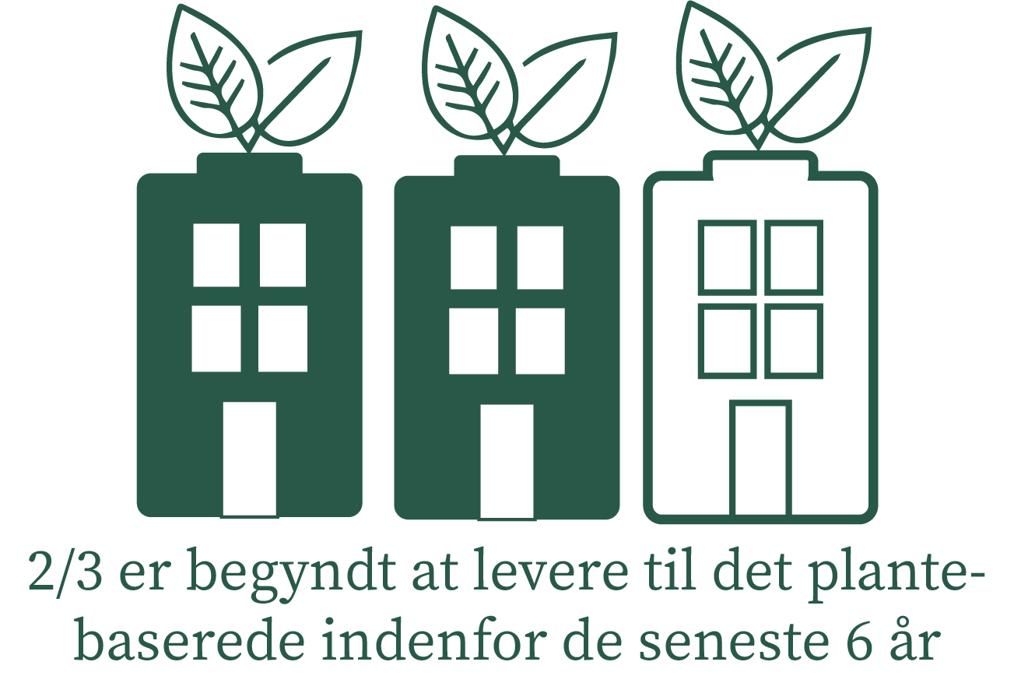

Background for plant-based food production
Small and medium-sized companies with primarily plant-based products:
Ideological motivation
Some "afraid" to call products vegan and vegetarian
Medium and large companies with existing animal production:
Expectation of growth by supplementing the product assortment
Små Store Mellemstore

Slide 26
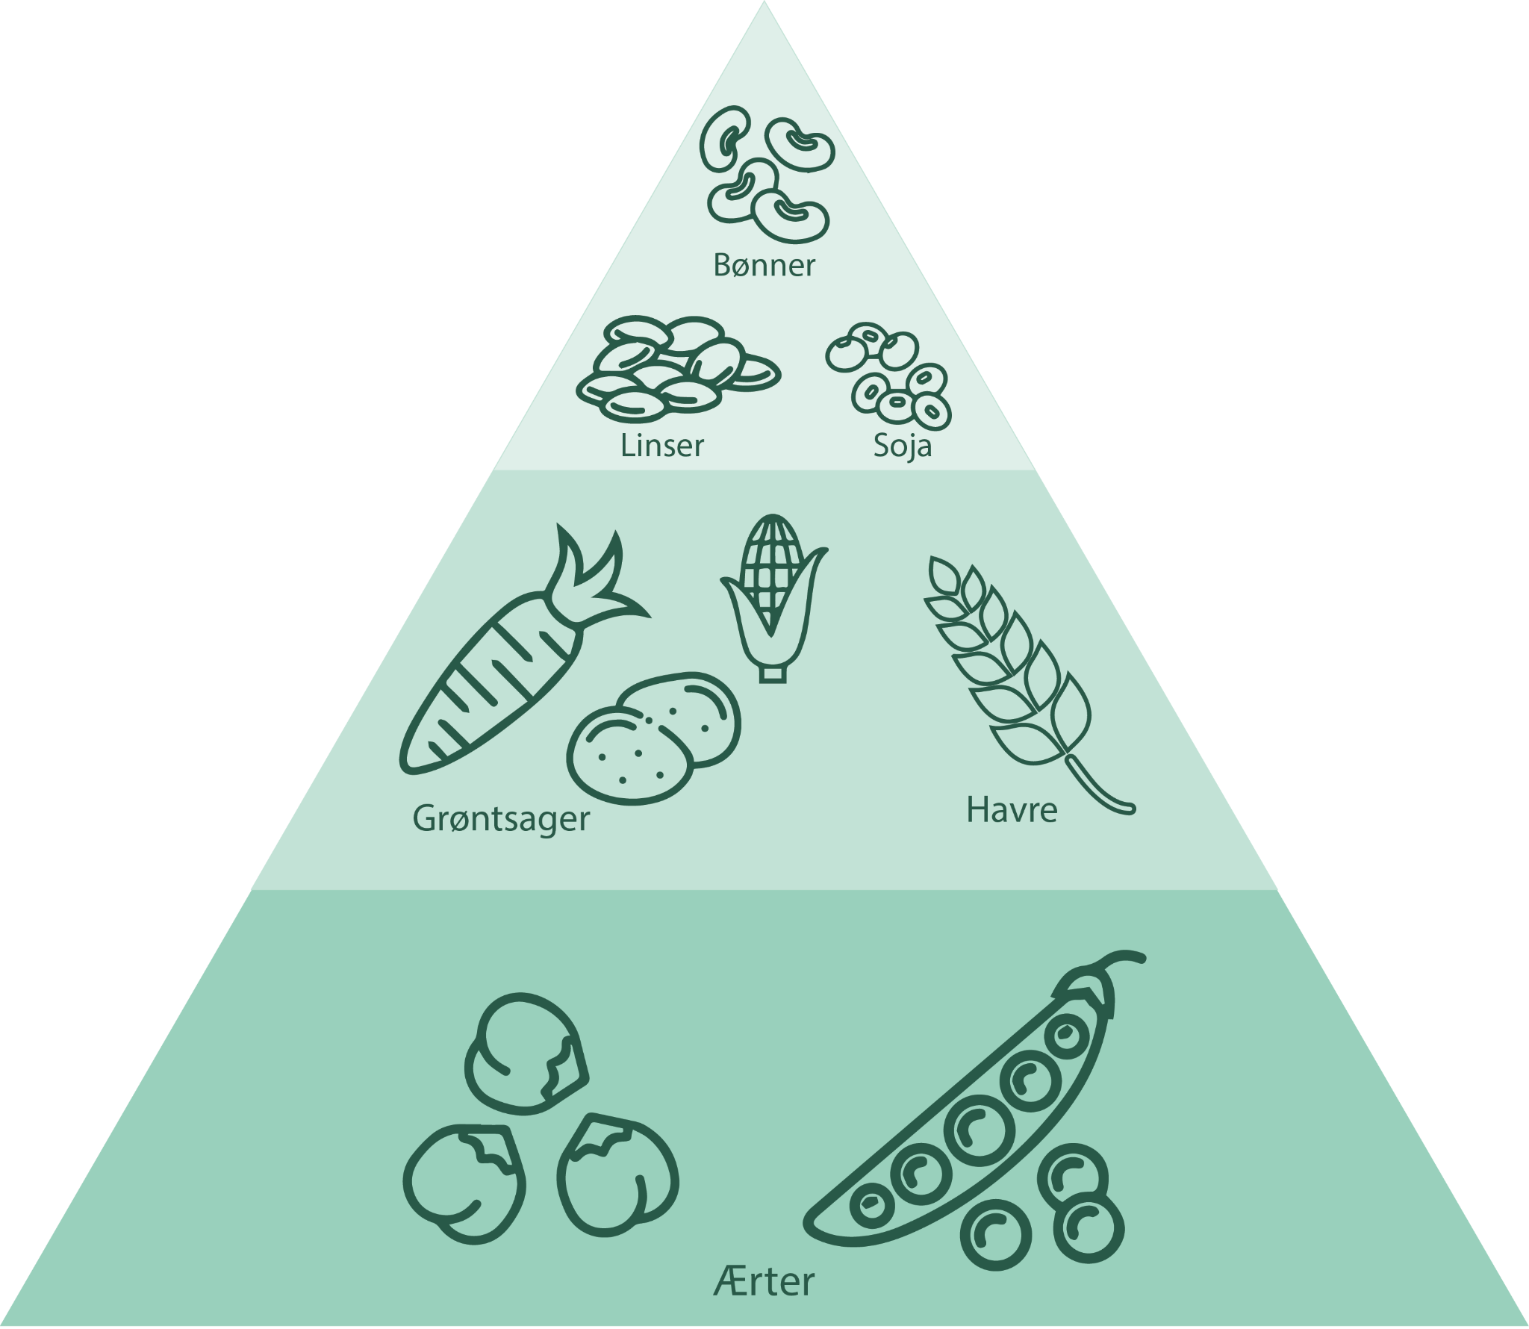
Products and raw materials
A large number produce or sell ingredients for products similar to meat or dairy products
…. or sells products that look like meat or dairy products
Many companies: Peas as a raw material basis
Fewer companies with other types of products: E.g. porridge mixes, liquid herbs, powder for herbal drinks, and tofu
7 out of 10 primarily purchase raw materials from Denmark and other Nordic countries

Slide 27


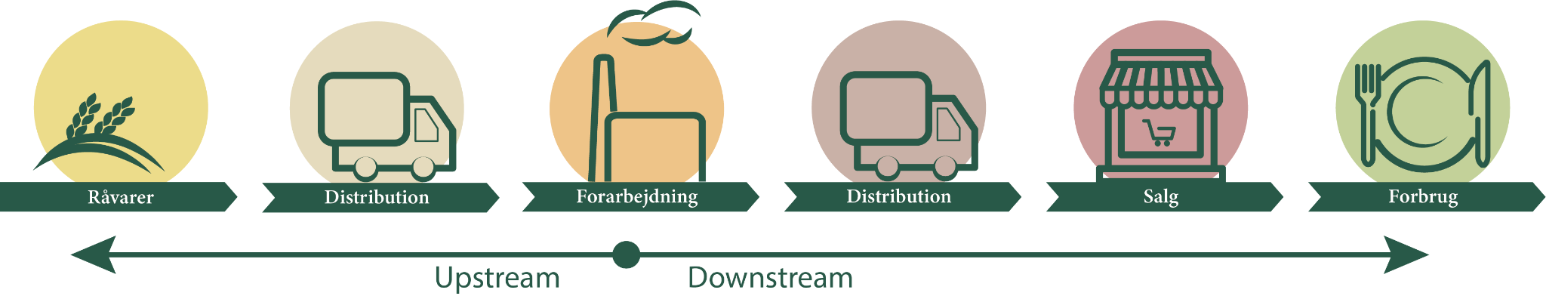
Value chain development
Missing links between raw material production and processing: Agriculture needs security of sale …… and processors need stable and fairly uniform supply =>needs for agreement … for agriculture and industry
Access to retail chains is a bottleneck....especially for small businesses. Incumbent industry dominate (some places)
Selling to food service: Lack of qualified labor in food service

Slide 28
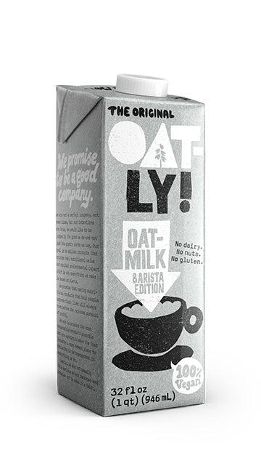
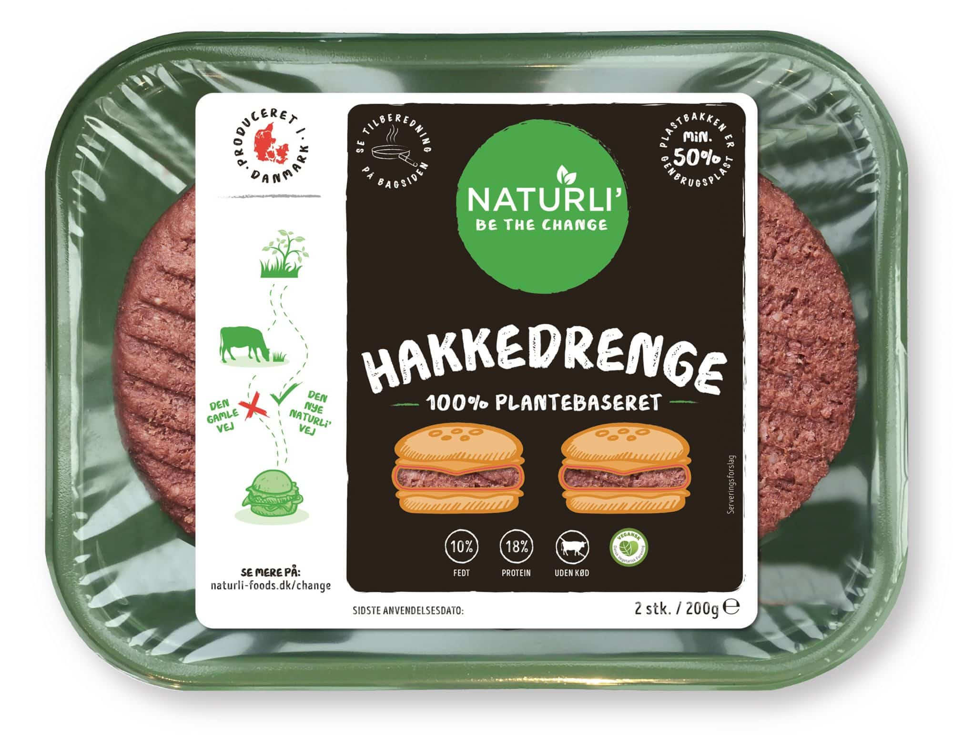
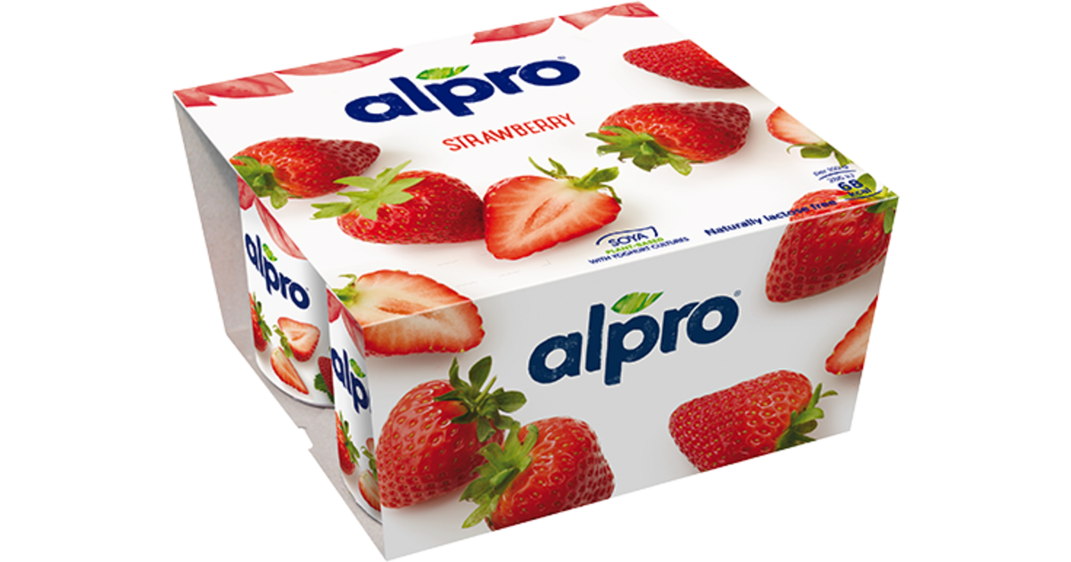
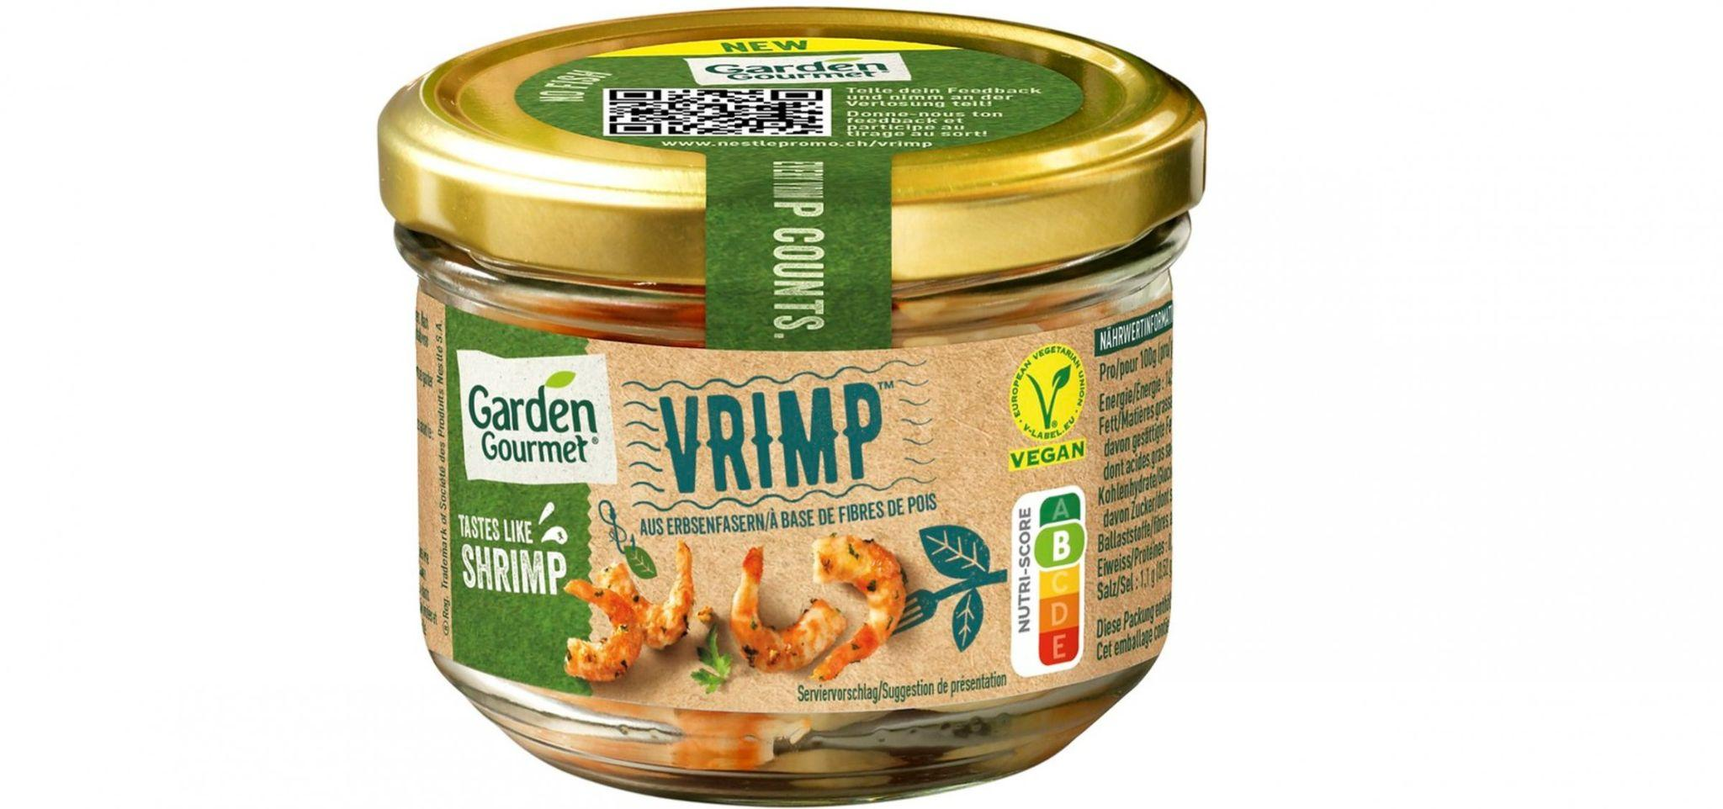
Experiences from consumer practices
Consumers reluctant
Judging plant-based products based on one bad experience
Mainly demand for products similar to meat and dairy products and convenience
Big difference in demand in rural and urban areas

Slide 29
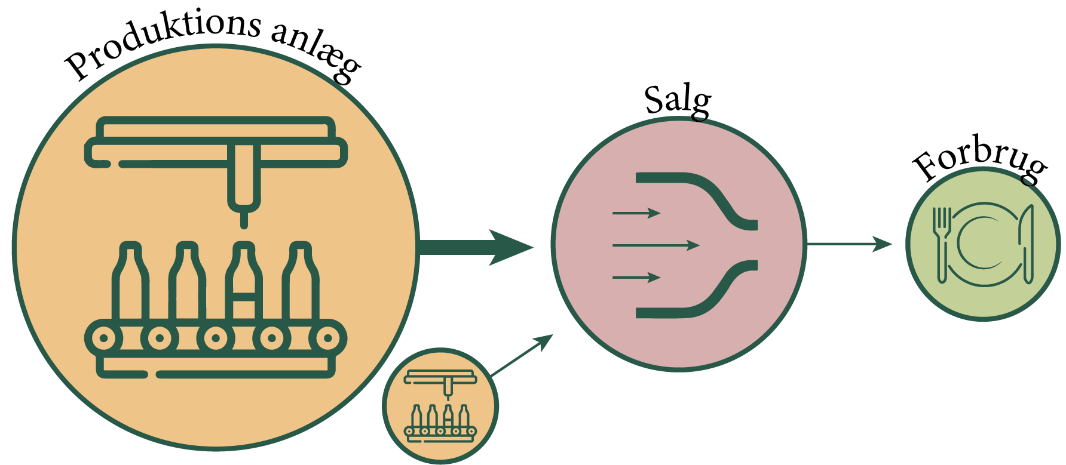
Economic challenges
Requires investment to get started
Large production machinery does not match well with small sales
Easier for smaller companies to produce for a niche market, but challenges entering retail
Difficult to develop from a startup to a commercial company

Slide 30
Regulatory measures supporting development of production and consumption of plant-based food

Slide 31
Measures for development of markets for "greener" products
Support production (supply) | Support consumption (demand)
Information: Dissemination of knowledge to companies about production methods and products. Professional kitchens need new knowledge | Information: Dissemination of knowledge to consumers about products. Many consumers need new skills: Cooking. Planning
Public regulation: Restrictions on production or rules and standards for sustainable production or products. Approval of some new foods slowly: Seaweed and algae products might need approval | Public regulation: Promotion of public procurement as part of market development. Price having big priority in public tenders
Economic incentives: Positive or negative incentives in relation to production or products. Funding for change of crops in agriculture: From fodder to food. DK: Funding for food innovation | Economic incentives: Positive incentives for consumers in the form of reduced taxes etc. for products. Only public subsidies for school milk
Organisation and infrastructure: New knowledge infrastructure for research, consultancy etc. New networks with existing food actors | Organisation and infrastructure: Organisation of labeling scheme. Danish climate-label for food!?
Ref.: Jørgensen et al (2022)
(Inspired by
Daugbjerg & Sønderskov, 2012)

Slide 32
Experiences from The Netherlands
Leveraged existing food innovation ecosystem to advance their position in the plant-based protein market
Crucial to food innovation in the Netherlands: The Food Valley with many forms of collaboration between companies and knowledge institutions
Increased production and consumption of plant-based food enabled through the establishment of several new innovation infrastructures: The Protein Community, The Protein Cluster, Proteins for Life and The Green Protein Alliance
Green Protein Alliance: 25 retailers, the catering industry, food manufacturers and 10 knowledge partners in the Netherlands. Supported by the Dutch government
Incumbent knowledge actor: Wageningen University, Institute for Food and Biobased Research: Proteins for Life

Slide 33
“Action plan for plant-based food” (Denmark, 2023)
Section 3.0: Strengthening Plant-Based Foods:
"Thus, there is great potential for a solid Danish contribution to the necessary global transformation of agriculture to a more plant-based food base. It is the government's vision that Denmark actively participates in this transformation, and that Danish agricultural production, agricultural exports and the Danish population's dietary habits inspire the rest of the world to a green transformation of the food systems.“
(Direct translation from Danish)

